Slide 1
Starter
Write a simple program to input and output a number. You must give the user the option to enter a number of their choice.
List 3 data types and briefly explain them.

Slide 2
Constants & Variables
Constant & Variable Declaration

Slide 3

Constant
An item of data whose value does not change
fixed for the duration of the program
values cannot be modified after their definition
can be of any of the basic data types
E.g. integer constant, floating constant, character constant or string literal
declared using the Const statement
assigned at run-time
Const PI = 3.14149

Slide 4

Variables
an item of data whose value could change while the program is being run
can be assigned at run-time
a place to store data
has a name and a data type
a variable’s name is known as the variable’s identifier
is declared using the Dim* (short for Dimension) statement = initializing *in VB.NET only
The scope of a variable determines which parts of the program can access its values.
Dim varName As varType
NOTE:
varName is the name of your variable.
varType is the data type of the variable.
*Types include string, integer, double, boolean, etc.
**Dim = Dimension; command used in Vb to declare variables.

Slide 5
Variable Scope
Will be covered later on in course.
Local
Global
accessible only from the method or block in which it is declared
used throughout the program
it is not always desirable to use global variables in complex programs – why?
Because it can be easy to change the value by accident
To find out more: http://www.youtube.com/watch?v=grz6iw5UT0w

Slide 6
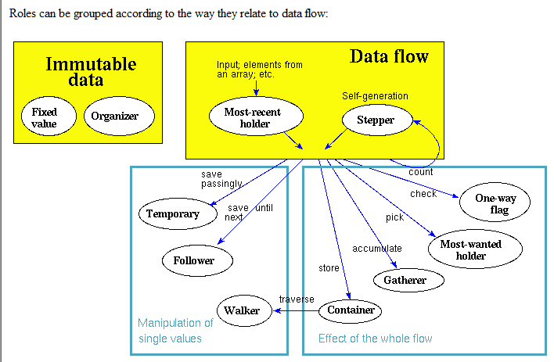
Roles of Variables

Slide 7
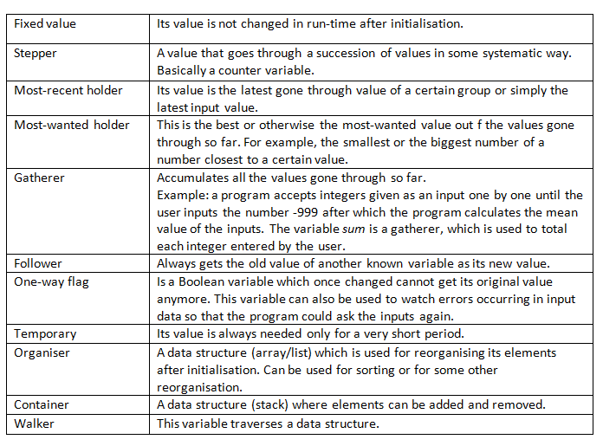
Note: temporary = = most wanted holder / transformation / follower

Slide 8
Example
The value 3 is being stored in the variable myNumber.
This statement cannot be written the other way around.
myNumber = 3

Slide 9
Identifier
Definition: a unique name given to variable, procedure, function, etc.
Meaningful Identifiers:
to describe what the variable/procedure/function contains/does.
poor variable names make it difficult to understand the code/to work out what is going on.

Slide 10
Class Task
Resource: ZigZag handout, pages 14 – 22
Data Types
Declaring variables in VB
Developing a calculation program in VB
Formatting output
Extension 1:
Explain the difference between variable & constant
Explain the advantages of using a named constant.
6. Extension 2: Task 2.12 (Practical Task) – ZigZag pg22
7. Recap questions (ppt)

Slide 11
Plenary Questions
1. Which piece of code is correct:
Code A:
Dim var As Integer
Var = 54
Code B:
Dim var As Integer
var = 54
Code C:
var = 54
Dim var As Integer

Slide 12
2. Explain the difference between variable & constant.
3. Explain the advantages of using a named constant.

